Slide 1
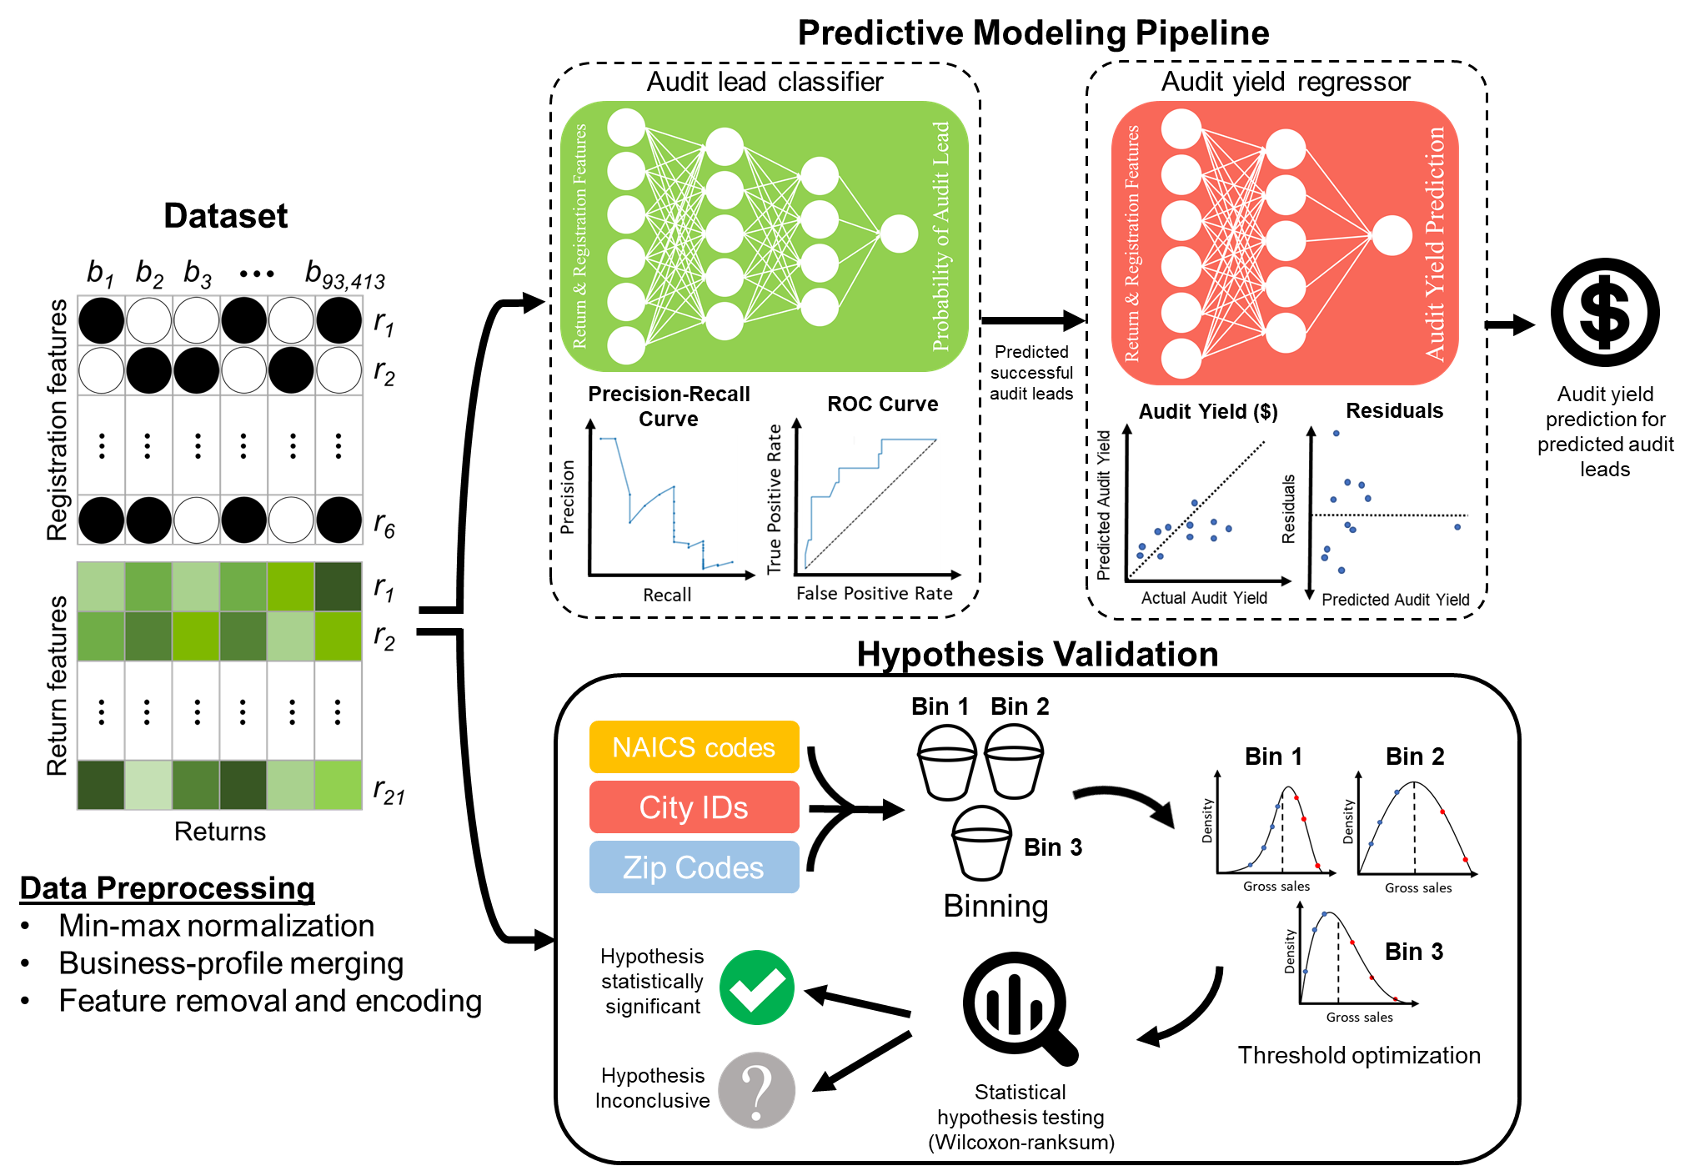
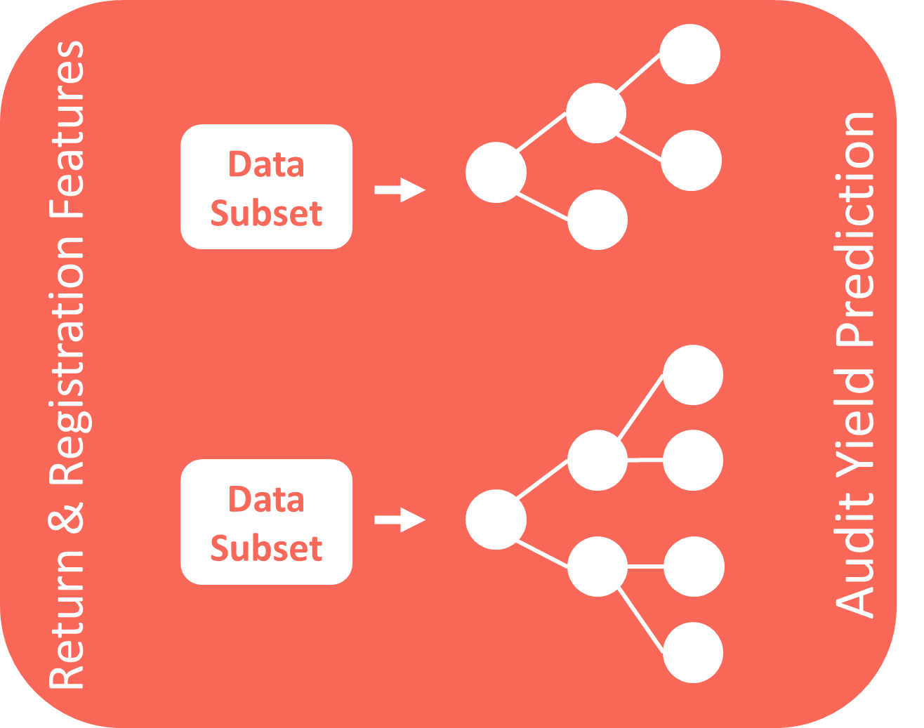

Slide 2
Data Subset
Return & Registration Features
Audit Yield Prediction
Data Subset

